Slide 1
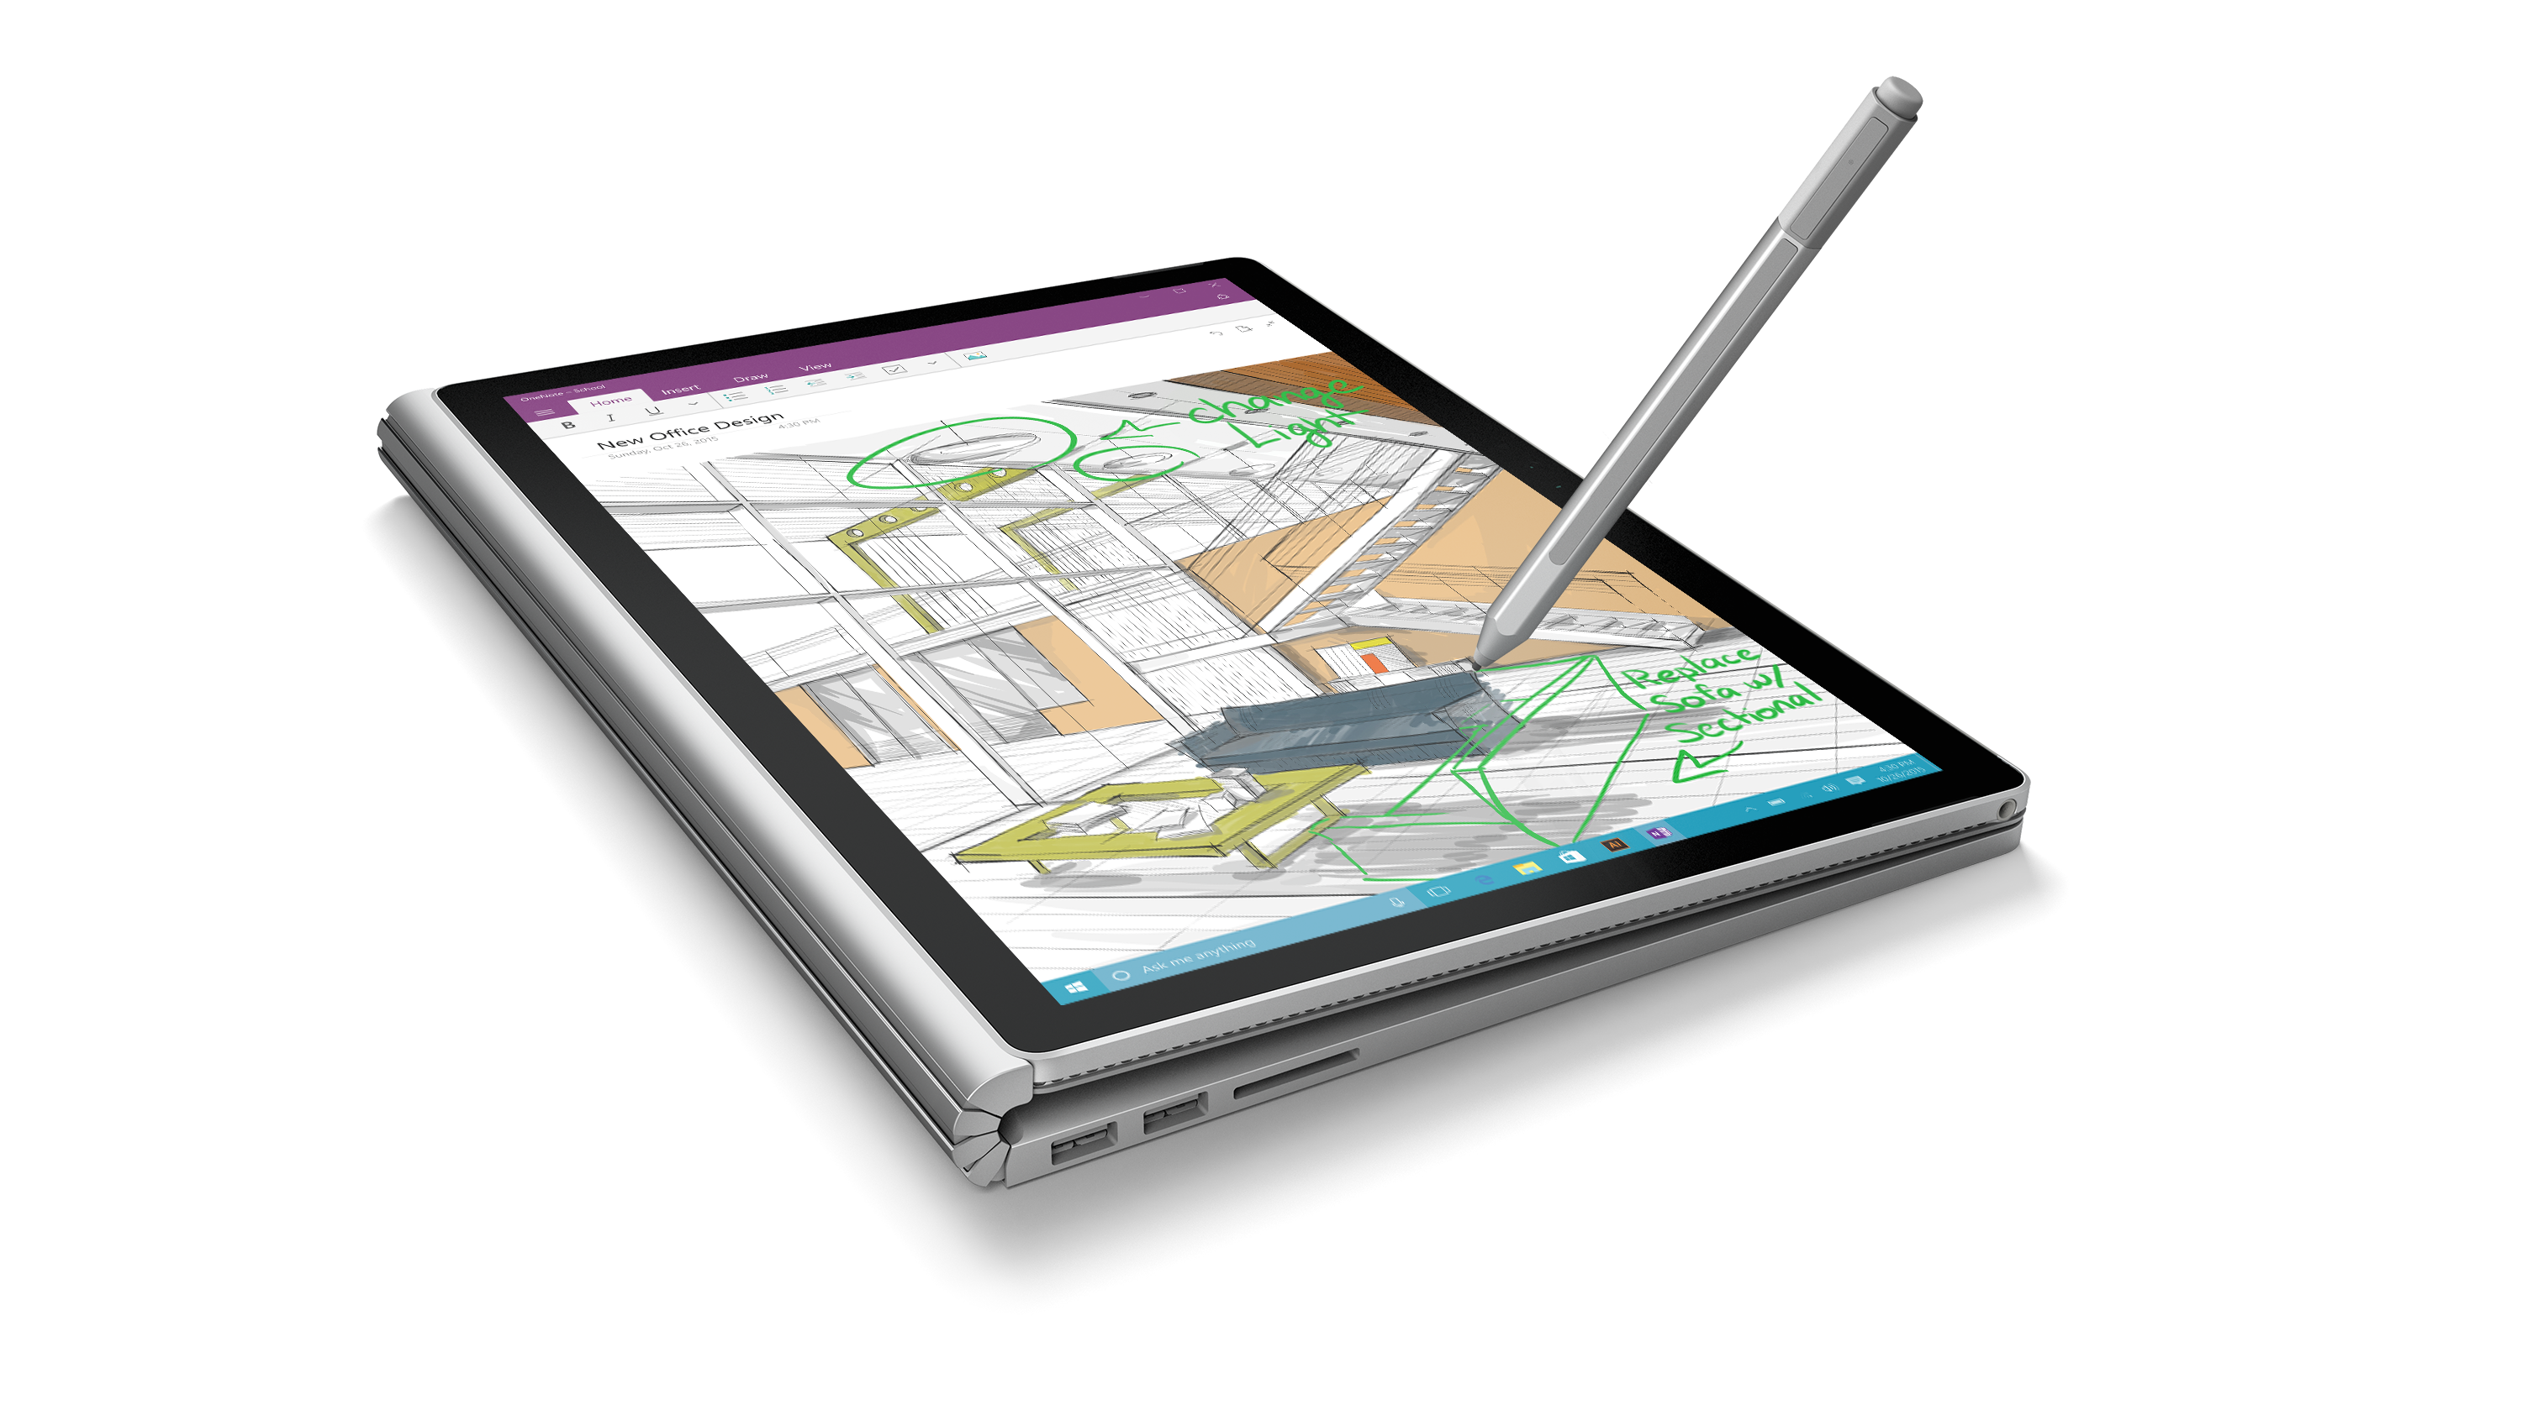
Windows 10 Developer Workshop
Larry Lieberman
Shen Chauhan

Slide 2
Agenda
Strategic and tactical details
Event preparation & setup
Content
Details
Objectives of each module
Presentation recommendations
Q&A
You are ultimately responsible for the success of your event
You should take initiative, make this presentation your own, and let us know what you changed!

Slide 3
Details: Objectives
Reaching out to developers who currently build for, or have built for Windows (the ‘friendlies’)
Follow through on our UWP developer story; Demonstrate the reality of what developers can achieve
New workshop format to drive deeper participant engagement
Socialize how to deliver the most compelling developer scenarios using UWP
Provide baseline education for delivering reasonable UWP app
Not objectives
Porting
Bridges (H2)

Slide 4
Details: Locations & Time table
10/29 | Belgium, Moscow
11/06 | Mumbai, Mexico City
11/12 | Rome
11/18 | Sao Paulo
11/19 | Netherlands
11/20 | Tokyo
11/21 | Beijing
11/25 | Vancouver, Istanbul
11/28 | Shanghai, Seoul
12/03 | Tel Aviv
12/09 | Dubai
12/10 | Warsaw
+
11/10 – 12/15 | 12 US Win 10 Events

Slide 5
Details: Preparation
Clone the repo on GitHub (https://github.com/Windows-Readiness/WinDevWorkshop)
1 proctor per 20 attendees
Instructor & proctor should all review the labs prior to the event
Software requirements
Windows 10 Pro or higher
VS 2015
Windows 10 SDK
Windows 10 Emulators (require SLAT)
Instructor Hardware
IOT (Optional)
Stylus
Continuum

Slide 6
Delivery Recommendations
SLLLLLLOOW down
But not TOOO slow
You don’t have to type every line of code
Copy & paste, & explain
Dual monitor… or dual virtual desktop might help
In some places, you may need to make some lab exercises “optional”; either for them to do at home, or as a straight demo

Slide 7
Delivery *NOTE*
PRACTICE
Notes:
This is pretty different from the ‘camps’ we’ve run in the past.
We believe it may drive deeper impact… walking the audience through the code, while they themselves code, means they get the tactile experience of actually making the code work, and they should get invested in it.
… BUT… it means more work for you!!
The labs were written for self-use… not demo steps
Thus, you have to go through them to figure out the steps you’re going to take in your presentation
We have very tight timeframes in this workshop… you’re not going to have ANY time to read in real time

Slide 8
Content: Day Recommended Agenda
09:30 – 10:00 | Setup
10:00 – 11:00 | 1. Intro
11:00 – 12:00 | 2. Adaptive UI
12:00 – 12:30 | 3. Tiles
12:30 – 01:30 | *Lunch*
13:30 – 14:30 | 4. Edge / Web
14:30 – 15:30 | 5. Cloud
15:30 – 16:00 | *Break*
16:00 – 17:00 | 6. MPC / (opt: App Svcs)
17:00 – 17:30 | 7. Store / $$

Slide 9
Module 1 | Introduction to Win 10 Dev | 60
Lecture
13 slides / 15 minutes (really just 6 intro slides)
2 labs
Hello UWP (inc. optional IOT deploy)
Getting started
Hello UWP across device
Hello UWP in Blend (opt)
Page navigation and back
Objectives
Lay the foundation on the purpose of the UWP and how it solves an enormous problem
Leverage page nav to demonstrate how one type of functionality can manifest different device types

Slide 10
Module 2 | Adaptive UI | 60
Lecture
15 slides / 15 minutes
1 demo, (calculator)
1 lab (building adaptive UI)
Evolve a fixed UI to adaptive (basic VSM)
Leverage RelativePanel
Build alternate XAML views
Objectives
Introduce adaptive UI principles, scaling, effective pixels, basic design techniques, Visual State Manager, etc.
Walk through how to build a page that adapts to different screen sizes and resolutions

Slide 11
Module 3 | Live Tiles & Notifications | 30
Lecture
15 slides / 10 minutes
Lab
Customize default tile
Create Adaptive tile
Interactive Toast (You might need to cut this one)
Objectives
Tile basics
Adaptive Template
Toast basics
Interactive Toasts
Note
Tile assets in “assets” folder

Slide 12
Module 4 | Edge & Web Apps | 60
Lecture
25 slides / 20 min
Lab
Web View
Hosted Web Apps
ManifoldJS (Optional)
Objectives
Using WebView control in WinJS app, adding HTML page to generate a toast
Creating a hosted web app from an Azure website
Install and use ManifoldJS to generate a hosted web app
Note
Lab currently has you publishing an Azure Website

Slide 13
Module 5 | Cloud Services | 60
Lecture
11 slides / 15 min
Lab
Getting started with AAS
Enable Auth, and connect to cloud
Enable offline sync
Objectives
Provide rich overview of Azure offerings for UWP apps
Demonstrate workflow to implement auth and sync
Notes
We’ve created the backend for you, (you don’t do task 1)
This one really requires practice
Notes:
While there are a lot of steps to this one; we think its REALLY important, because we think there is a key platform differentiator in the UWP / Azure connection

Slide 14
MPC | 60 (or 30 if no Cortana)
Lecture
21 slides / 20 min
Demo
Option to demo Windows Hello
Lab
Launching apps with Speech through Cortana
Working with Ink Input
Objectives
Describe ‘MPC’ all up
Windows Hello / Passport
Describe speech developer features (Command, Reco, Synth)
Describe Ink platform
Notes
Lab 1 (Speech through Cortana) will be optional based on your region

Slide 15
App Services | 30 (only if no Cortana)
Lecture
13 slides / 20 min
Lab
Create/register app service
Call the service in background from another app
Pass data back and forth
Debug
Objective
Provide the (very) quick run through of app service functionality available in UWP

Slide 16
Store & Monetization | 30
Lecture
9 slides / 15 min
Lab
Integrating Interstitial Ads
Objectives
Provide the lab around how to publish your app

Slide 17
Questions!

